Slide 1
Indian Startup Funding
Submitted By-
Amit Ramesh Jaiswal

Slide 2

Startups may be small companies but they can play a significant role in economic growth. They create more jobs which means more employment, and more employment means an improved economy.

Slide 3

DATA SOURCE- https://www.kaggle.com/sudalairajkumar/indian-startup- funding
Video Link - https://drive.google.com/file/d/1mN6qviofpR7J5M39Y0IWwjmnH-puCyR7/view?usp=sharing

Slide 4
Objective – 1
Top Funded Startup
Result and Analysis
This are the Some Top Funded Startup in India among which “Paytm” is at the First Place then at Second Place “Flipkart” and at the Third Place “Ola”.

Slide 5
Objective – 2
Top Investors In Startups
Result and Analysis
Top Investors in Startups of India are namely
Such as Microsoft ,eBay ,Tencent Holdings and Steadview Capital and existing investors

Slide 6
Objective – 3
Types Of Investment
Result and Analysis
There are various types of Investment in such as Crowd funding ,Debt funding, Seed funding, Private funding etc. among which Private Equity investment is very large as compared to other investment.

Slide 7
Objective – 3
Industry Verticle
Result and Analysis
There are various types of Industry verticle are currently in market but among them E-commerce & M-Commerce Marketplace is having more investors.

Slide 8
Objective – 3
Sub-Industry Verticle
Result and Analysis
In Sub-Industry Verticle there are also E-Commerce and Horizontal Online Marketplace is having more investment.

Slide 9
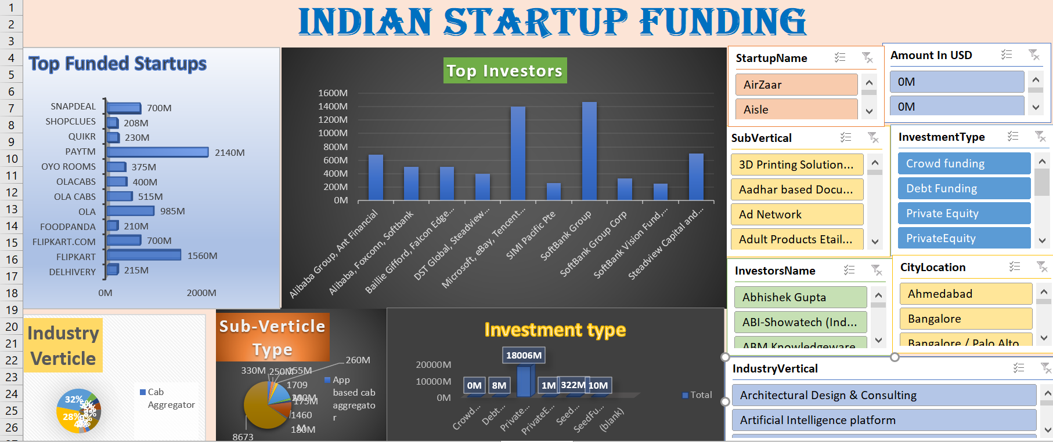
Dashboard

Slide 10

Worst affected states at states are Maharashtra and Gujrat more than 1000 cases are reported in month of April.

Slide 11
Thank You

